Slide 1
Parking Management System

Slide 2
Presented by:- Sontana Geetasri-200101120062 Chandan Mishra-200101120064 Baratam Pavan-200101120065

Slide 3
INTRODUCTION
A parking management system automates a car parking system .it optimizes parking space and processes efficient .it gives real time parking information such as vehicle and slot counts, available slots display ,reserved parking ,pay options, easy payments ,reports and a host of other features.
By managing parking wisely and efficiently not only on a community level but also on a smaller scale ( in business , hotels, malls),we can ease traffic in the community and help increase productivity by allowing more people to use their time on activities that are more important than looking for a parking space .

Slide 4
Scope of the project
The scope of the project is to polish our skills in programming, and for better understanding, and to accomplish good grades.

Slide 5
Read
noc=0,notr=0,nocy=0,nobi=0,amount=0,count=0
START
While(1)
Switch(menu)
Case1: car();
break
Case2: bike();
break
Case3: cycle();
break

Slide 6
case4 : showdetails();
break
Case5 : delete();
break
Case6 : exit();
Display
“invalid choice”
end

Slide 7
Int menu
Void delete
Read ch
Nocar=0
Display
Enter car
Enter cycle
Enter bike
Show details
Delete data
exit
Nobike=0
Nocycle=0
Notrucks=0
Amount=0
Return ch
Count=0
stop
stop

Slide 8
Void showdetails
Void car()
Display
Number of cars =nocar
Number of cycles = n0cycle
Number of bikes = nobus
Number of trucks = notruck
Total number of vehicles = count
Total gain amount = amount
Print
“entry succesfull”
Nocar++
Amount=amount+100
stop
Count++
end

Slide 9
Void bike()
Void cycle()
Void truck()
Print
“entry succesfull”
Print
“entry succesfull”
Print
“entry succesfull”
Nobike++
Nocycle++
Notrucks++
Amount=amount+50
Amount=amount+20
Amount=amount+200
Count++
Count++
Count++
end
end
end

Slide 10
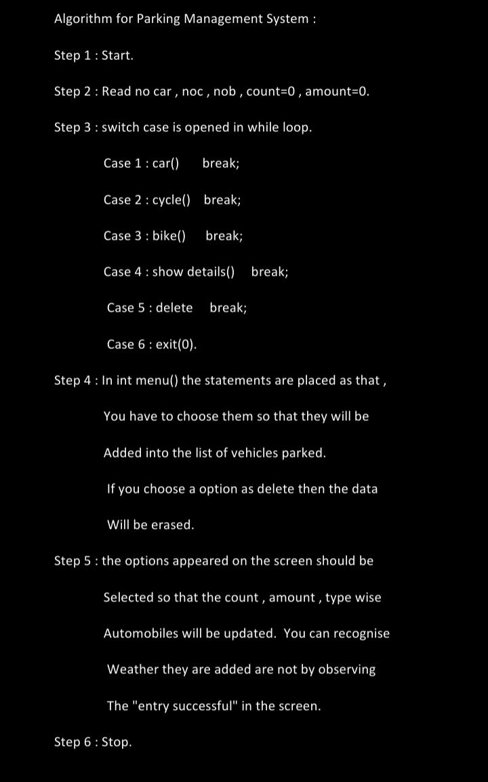
A
L
G
O
R
I
T
H
M

Slide 11
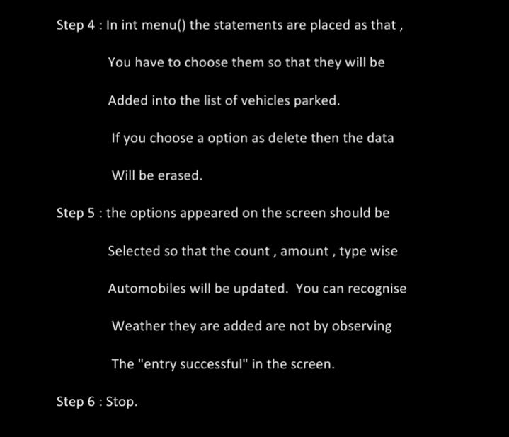
A
L
G
O
R
I
T
H
M

Slide 12
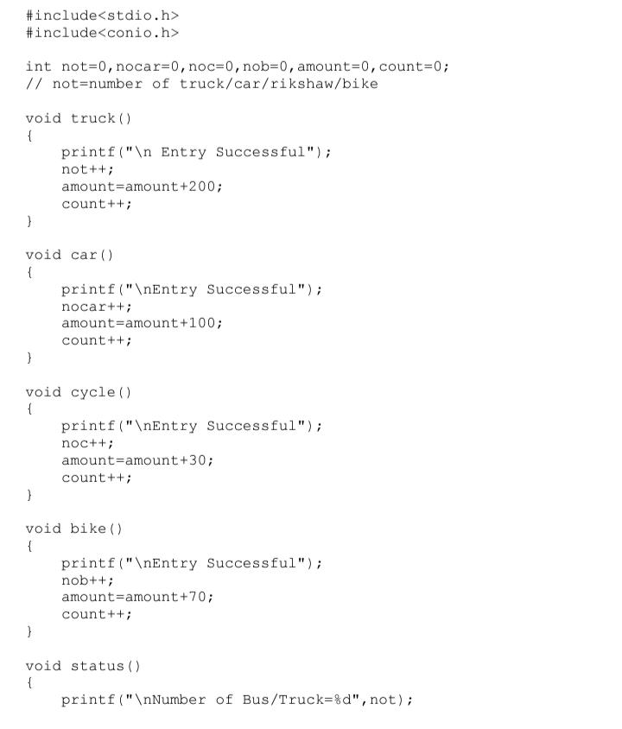
C
O
D
E

Slide 13
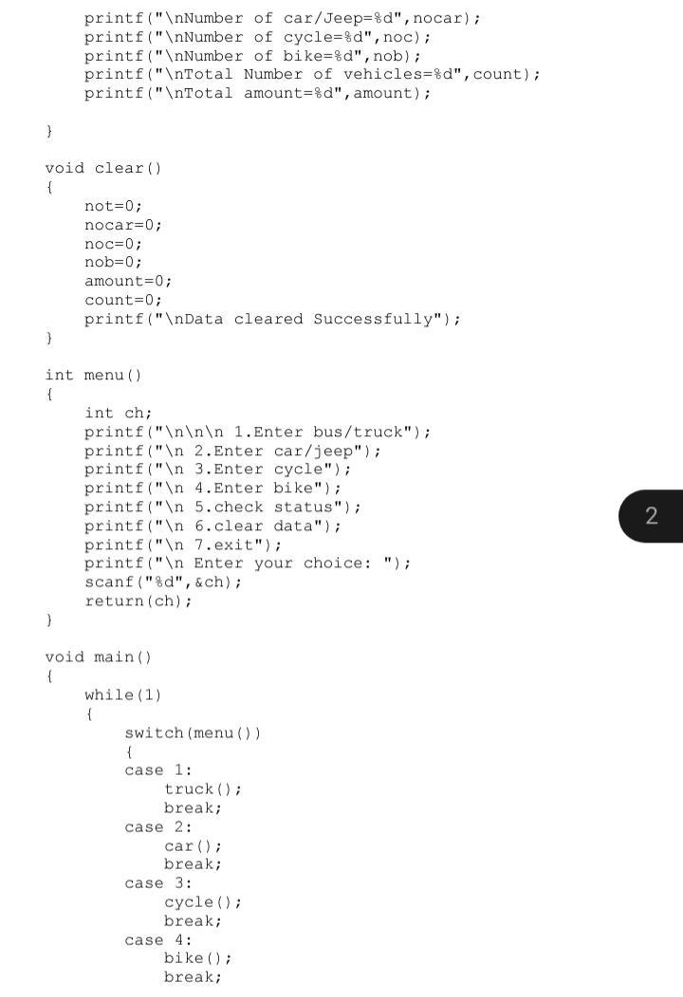
C
O
D
E

Slide 14
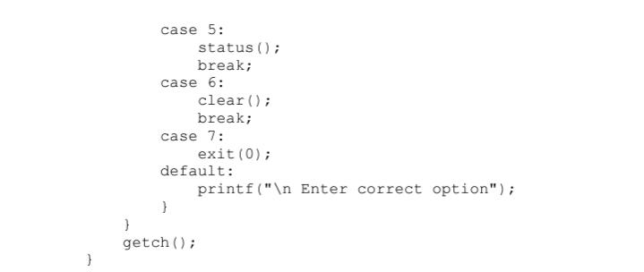
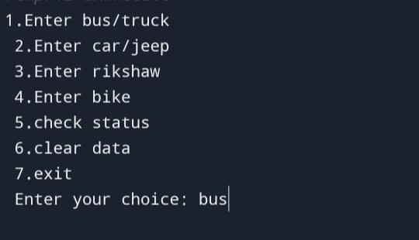
C
O
D
E
O
U
T
P
U
T

Slide 15
THANK YOU

